Slide 1


BackdoorHunter: Poisoned Training Data Removal via Contrastive Responses under Pruned Models
The 18th International Conference on Knowledge Science, Engineering and Management (KSEM 2025)
Rixi Liang¹, Shuai Zhou¹*, Mingxu Zhu¹, Chi Liu¹, and Minfeng Qi¹
City University of Macau, Macao, China
The 18th International Conference on Knowledge Science, Engineering and Management (KSEM 2025)

Slide 2
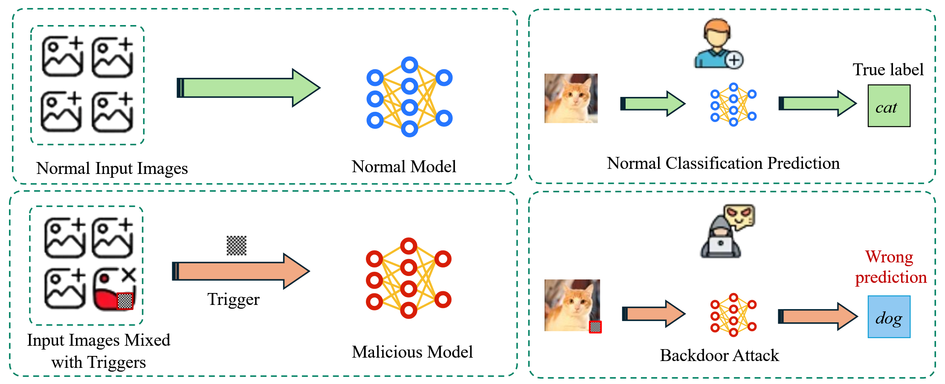
Background: What is a Backdoor Attack?
1.Attackers inject hidden "triggers" into training data to create a backdoor.
2.The compromised model behaves normally on clean data, making it highly stealthy.
3.The trigger forces the model to a specific, malicious prediction, ignoring the real input.
1. Introduction | 2. Our Method: PMRF | 3. Experiments & Results | 4. Conclusion

Slide 3
Challenges & Limitations of Existing Defenses
1. Data Preprocessing & Detection
❌ Limitation: These methods fail when backdoor features are weak, intentionally suppressed by attackers, or when poison rates are low.
2. Model-based Defenses (e.g., Fine-tuning, Pruning)
❌ Limitation: They often degrade the model's performance on clean data and may require additional trusted data to restore accuracy.
3. The Core Challenge
⚠️ Limitation: Existing defenses are mostly reactive. A proactive defense that removes threats before model training is urgently needed.
1. Introduction | 2. Our Method: PMRF | 3. Experiments & Results | 4. Conclusion

Slide 4
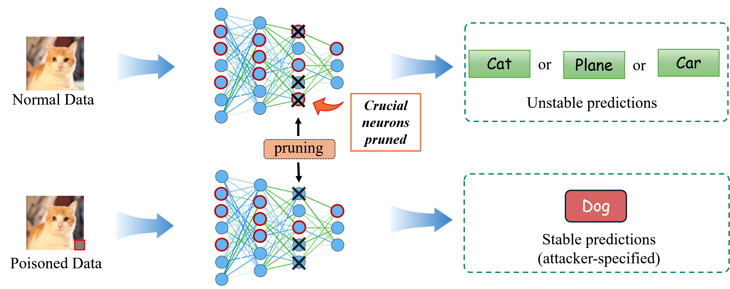
Our Core Idea: Defense by Pruning
Key Insight: Clean and poisoned samples exhibit different behaviors under pruned models.
Normal Data:
Relies on complex features from many neurons. Pruning disrupts feature extraction, leading to unstable predictions.
Poisoned Data:
Relies on a simple "shortcut" from the trigger. This shortcut often survives pruning, leading to stable (but wrong) predictions.
1. Introduction | 2. Our Method: PMRF | 3. Experiments & Results | 4. Conclusion

Slide 5
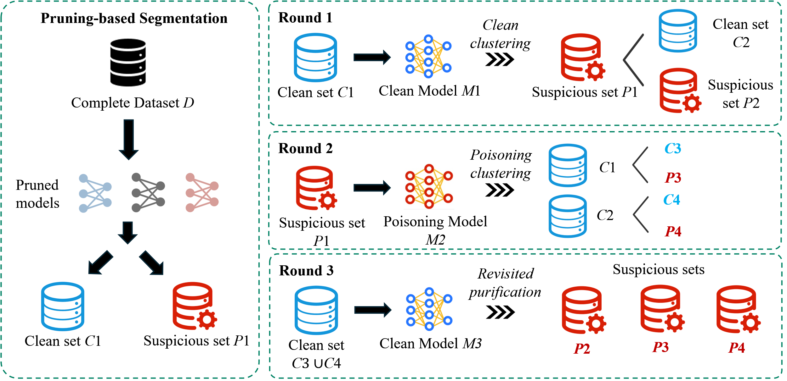


Methodology Overview: PMRF
Our method, PMRF, consists of two main stages:
Pruning-based Segmentation:
We leverage behavioral differences under pruning for an initial separation of clean and suspicious data.
Mutual Reinforcement Filtering:
A three-round filtering process is then used to iteratively purify the datasets, leading to a highly accurate separation.
1. Introduction | 2. Our Method: PMRF | 3. Experiments & Results | 4. Conclusion

Slide 6




Step 1: Pruning-based Segmentation
1. Train a Full Model
2. Generate Pruned Models
First, train a standard model on the entire, potentially poisoned dataset.
Create k=5 pruned models using a threshold (T) of 65% for VGG16 and 55% for ResNet-18.
3. Verify Each Sample
4. Separate Datasets
Pass every sample from the original dataset through all k pruned models.
Consistently correct -> Suspicious Set ($D_s$)
Unstable classification -> Clean Set ($D_{clean}$)
1. Introduction | 2. Our Method: PMRF | 3. Experiments & Results | 4. Conclusion

Slide 7

Step 2: Mutual Reinforcement Filtering
Round 1: Clean Clustering
Action: Train a "Clean Model" on $D_{clean}$. This model, unfamiliar with triggers, tends to misclassify triggered data from $D_s$.
Round 2: Poisoning Clustering
Action: Train a "Poisoned Model" on suspicious data from Round 1. This model excels at detecting triggers and is used to find any remaining poisoned samples in $D_{clean}$.
Round 3: Revisited Purification
Action: Train a final, ultra-pure "Clean Model" on all data confirmed as clean. This model performs a final check to ensure maximum purity.
1. Introduction | 2. Our Method: PMRF | 3. Experiments & Results | 4. Conclusion

Slide 8





Experimental Setup
Dataset
Models
Cifar-10
Poisoning Rate: 0.3%
(for main results)
VGG16
ResNet-18
Attacks Tested
Evaluation Metrics
BadNet
Blend
TaCT
Trojan
ACC (Clean Data Accuracy) (Higher is Better)
ASR (Attack Success Rate) (Lower is Better)
NVIDIA RTX 4060Ti < 2 hours
1. Introduction | 2. Our Method: PMRF | 3. Experiments & Results | 4. Conclusion

Slide 9
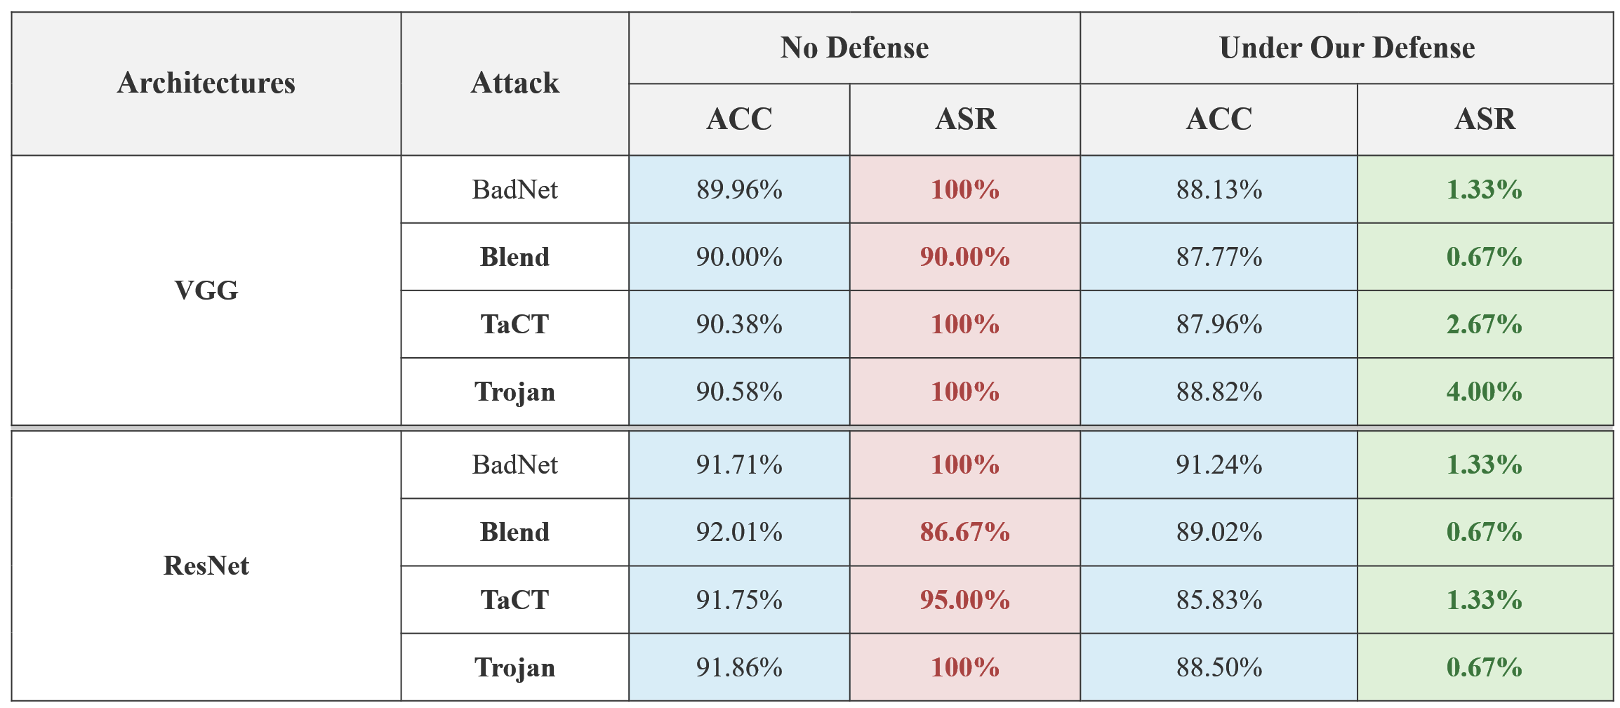
Main Results: PMRF Effectiveness
PMRF significantly reduces ASR to near-zero while maintaining high ACC across all scenarios.
1. Introduction | 2. Our Method: PMRF | 3. Experiments & Results | 4. Conclusion

Slide 10
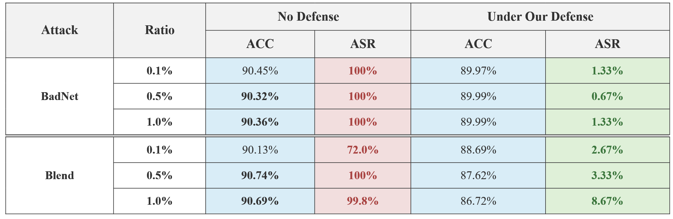
Robustness to Varying Poisoning Rates
PMRF maintains strong defensive performance across a range of poisoning ratios (0.1% to 1.0%), proving its robustness.
1. Introduction | 2. Our Method: PMRF | 3. Experiments & Results | 4. Conclusion

Slide 11
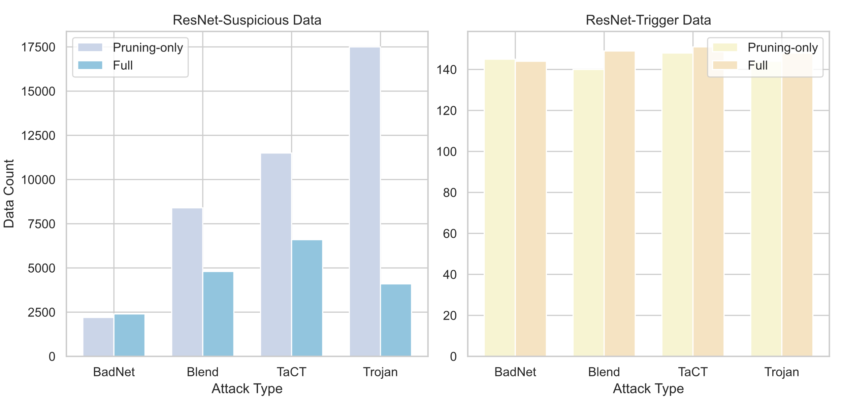
Ablation Study: Efficacy of Mutual Reinforcement Filtering
Pruning-only:
Identifies a large set of suspicious data, but includes many clean samples (high false positives).
Full PMRF Method:
Significantly refines the suspicious set, reducing its size while retaining almost all of the actual trigger data.
Conclusion: The Mutual Reinforcement Filtering stage is crucial for precisely isolating poisoned samples.
1. Introduction | 2. Our Method: PMRF | 3. Experiments & Results | 4. Conclusion

Slide 12



Conclusion
A Novel Proactive Defense
We proposed PMRF, a novel, proactive pre-training defense against backdoor attacks.
Innovative Mechanism
Proven Effectiveness
PMRF leverages the contrastive behaviors of samples under pruned models and a mutual reinforcement filtering process.
Experiments show PMRF significantly reduces ASR with only a minimal impact on ACC.
1. Introduction | 2. Our Method: PMRF | 3. Experiments & Results | 4. Conclusion

Slide 13
Thank You!
Q & A
Rixi Liang
City University of Macau
D24091110122@cityu.edu.mo

